Slide 1

Prediction of suicidal behavior in twitter data using machine learning
Supervised By
Md. Tohedul Islam
Assistant Professor
Department of Computer Science
Faculty of Science and Technology
American International University-Bangladesh
Presented By
1. Bushra, Mahfuzatul – 16-31040-1
2. Noman, Abdullah Al – 16-32102-2
3.Fahmida, Maisha – 16-32192-2
4.Tareq, Md. Ikram – 16-32231-2

Slide 2

overview
Introduction
Research Questions
Literature view
Methodology
Results Analysis
Future works
Conclusion

Slide 3

Introduction
Why this topic?
Why people try to attempt suicide?
Suicide prediction model

Slide 4
Research Questions
1. How can we predict suicidal case activity by tweets?
2. What attribute should consider and to detect suicidal case?

Slide 5
Literature Review
Limitations of studied Research Paper :
1.Most of the cases these papers use data from many years ago, means didn’t use recent data.
2. Lacking of data cleaning.
3.For proper data cleaning their result is not specific.

Slide 6
Literature Review
Why is our model different?????
1.By using twitter API and Python Programming language we have collected recent data.
2. Data cleaning is done by using LIWC and R language.
3.By the end we have 20 specific reasons as our result.

Slide 7
Methodolody
1.Data Collection
2.Data Preprocessing
3.Features Selection and Dataset Categories
3.Training The Model
4.Use leaps package on the dataset
5.Apply Classification Algorithms

Slide 8
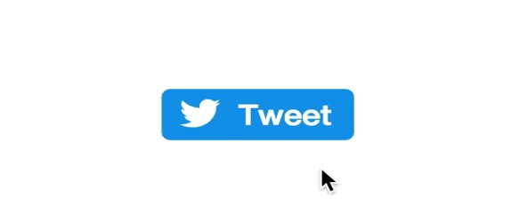


Data collection
1.Apply for a developer account.
2. Fill out the form.
3. Create an app named ‘user tweets scrapping app.
4. Twitter granted our access.
5.Generate a bearer token.
6.Use python programming language.
7.Convert tweets to Csv.

Slide 9
Data Preprocessing
1.Remove all noisy data.
2. Translate all text into English.
3. Text analysis By LIWC tool.
4.Feature Selection and Dataset Categories

Slide 10
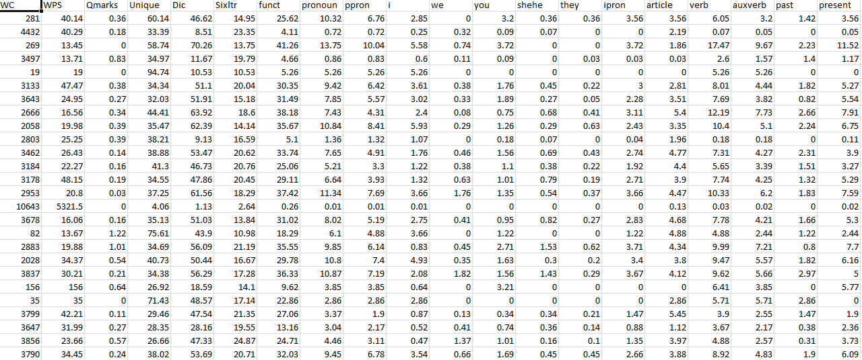
A part of The Training Dataset

Slide 11
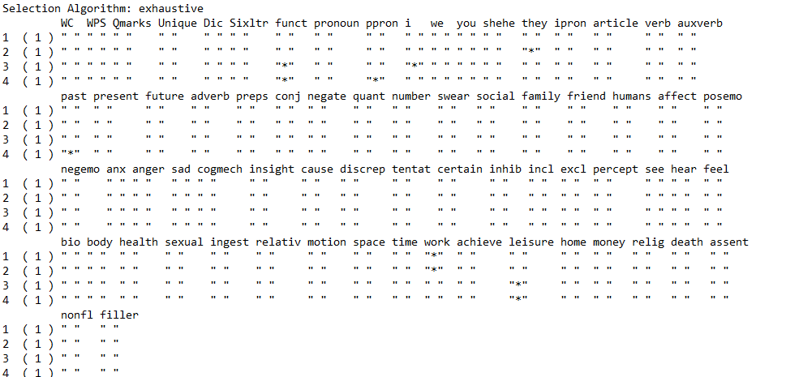
Using leaps package on the dataset

Slide 12
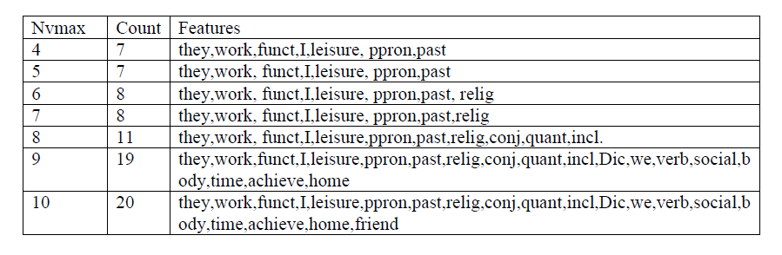
Features count and list for different nvmax value

Slide 13

Classification Algorithms
1.Naïve Bayes
2. IBK(K-NN)
3. Support Vector Machines (SVM)
4. J48
5. Random forest

Slide 14
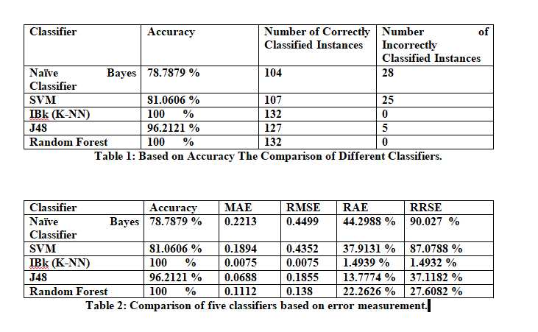
Result Analysis

Slide 15
MAE and RMSE Metrics

Slide 16
RAE and RRSE Metrics

Slide 17
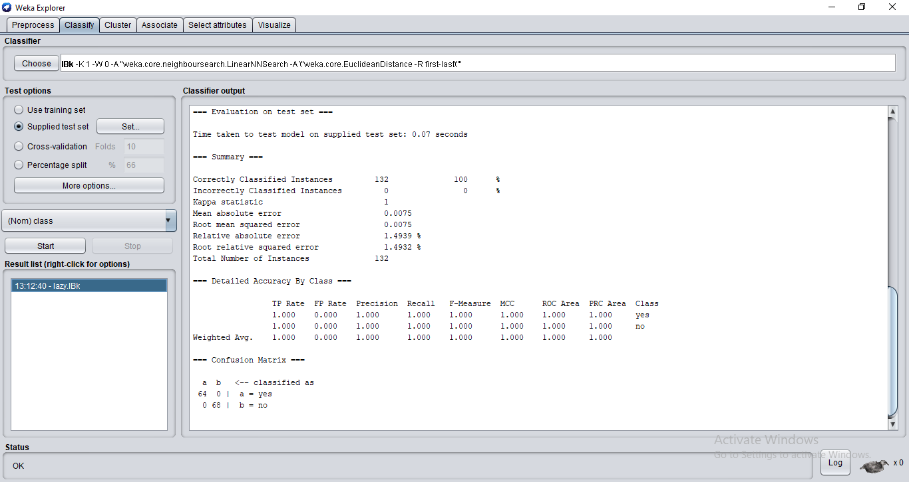
Value of the Test Set with Actual and Predicted Class

Slide 19
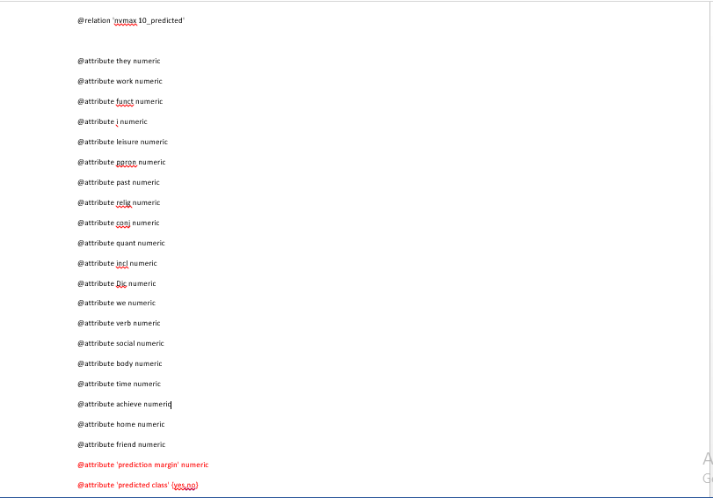
After Evaluating the Training Dataset the Result has shown

Slide 20
Predicted variables
1.They 15.social
2. Work 16.body
3. Funct 17.time
4. I 18.achieve
5. Leisure 19.home
6.ppron 20.friend
7. Past
8.Relig
9. Conj
10.Quant
11.Incl
12.Dic
13.We
14.Verb

Slide 21
Limitations of this Research:
1.This research is done only with the information of the American people,
2. It can be wrong for other countries.
3. So far we have not used any IoT or smart technology for this.

Slide 22

Future work
Use this method on big data set
Web application development

Slide 23
Conclusion
The aim of this study is to improve the accuracy of suicide rate predictions. A generalized model is designed that undoubtedly help the people to predict someone’s suicidal activity in advance based on some attributes value and according to that prediction the people can take necessary steps.

Slide 25


Any Questions?

